Slide 1
SYSTEMS THINKING
Martha Osei-Yaw
New Jersey City University
EDTC 813

Slide 2
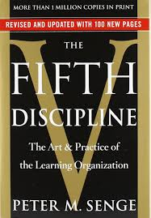
Learning Organizations
“The organizations that will truly excel in the future will be the organizations that discover how to tap into people’s commitment and capacity to learn at all levels in an organization” (Senge,2006,p.4).
-Peter Senge
The Fifth Discipline

Slide 3
Dysfunctions of an Organization
“When people in organizations focus only on their position, they have little sense of responsibility for the results produced when all positions interact”(Senge,2006, p.19).

Slide 4
Systems Thinking: A Conceptual Framework
Systems Thinking
Personal Mastery
Mental Models
Building a Shared Vision
Team Learning
Building the Learning Organization
(The Fifth Discipline, Senge 2006).

Slide 5
Building the Learning Organization
Systems Thinking
Personal Mastery
Mental Models
Building a Shared Vision
Team Learning
Understanding the framework
Committing to lifelong learning
Transforming a fixed point of view
Establishing a common identity
Maintaining “genuine” dialogues

Slide 6
Systems Thinking
What is a systems thinking approach?
A conceptual framework
The ability to focus on the needs of the organization as a whole
A means to problem solving at an organizational level

Slide 7
Personal Mastery
How do you define personal mastery?
Expertise in a specific area
A commitment to lifelong learning
The ability to maintain reflective practices
Lifelong learning on both a personal and organizational level

Slide 8
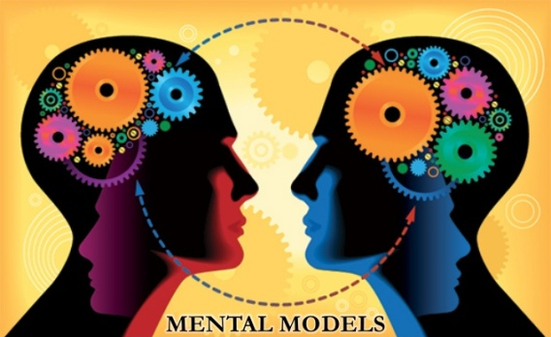
Mental Models
What are mental models?
A fixed way of thinking, an assumption or a generalization that impacts our behavior
If left unnoticed, these internal images can be limiting and can serve as stopping agents

Slide 9
Espoused Theory vs. Theory-in-Use
There is sometimes a conflict between what we say (Espoused Theory) and what we do (Theory-in-Use)
Reflective practices afford the opportunity to identify the gaps between the two theories
These reflective practices are vital to any organization
(The Fifth Discipline, Senge 2006).

Slide 10
Espoused Theory vs. Theory-in-Use
Working example:
Espoused Theory: Teachers often say that their students are not motivated to learn.
Theory in Use: During classroom observations, more often than not, teachers are seen delivering instruction in a traditional manner reflective of a “one size fits all model.”
It’s quite possible that the students are not motivated because the instruction is not individualized to meet their specific needs.

Slide 11
Leaps of Abstraction
Leaps of abstraction occur when we automatically generalize or jump to conclusions which are unfounded
It is a result of making a generalization without first testing it
Untested generalizations can lead to further unsubstantiated generalizations
(The Fifth Discipline, Senge 2006).

Slide 12
Leaps of Abstraction
Working Example: Teachers are taking a leap of abstraction with the espoused theory that students are unmotivated to learn.
Teachers are assuming the lack of student engagement is associated with motivation
If teachers tested their theory, they might uncover some underlying reasons for the lack of motivation (learning disabilities, lack of background knowledge, a language barrier, etc.)

Slide 13
Building a Shared Vision
How do you create a shared vision?
Design a set of principles and guiding practices which will serve as a driving force
Establish a sense of commonality
Develop a genuine vision that involves all stakeholders

Slide 14
Team Learning
How do you build team learning?
Align and develop the capacity of all members
Embrace “genuine” dialogue and the ability to think as a team
Provide opportunities to learn as a team

Slide 15
The Systems Approach in Educational Technology
How do you create sustainability?
Create an ecosystem to support and transport information
Seek tools to create new content
Extend learning by communicating and sharing content
Challenge traditional pedagogy
Source: http://www.edutopia.org/blog/building-your-tech-ecosystem-beth-holland

Slide 16
Universal Design for Learning
Implementation in the World Languages Classroom
Systems Thinking
Personal Mastery
Mental Models
Building a Shared Vision
Team Learning
Creating a UDL model for all
Becoming an expert in the field
Removing preconceived notions
Establishing a school-wide vision
Tapping into the strengths of all members

Slide 17
The Flipped Classroom
Systems
Thinking
Personal Mastery
Building a Shared Vision
Team Learning
Mental Models

Slide 18
Constructivist Technology Proposal
Using Augmented Reality to Bring the Curriculum to Life
Systems Thinking
Personal Mastery
Mental Models
Building a Shared Vision
Team Learning
Viewing early childhood as part of a greater system
Committing to Lifelong learning
Becoming a reflective practitioner
Establishing a school-wide vision
Learning beyond the individual

Slide 19
Current Challenges in Implementation
Findings based on an existing urban school in the state of New Jersey:
A systems approach is not currently existent
The current mental models are aligned to a traditional pedagogy
There is a lack of a shared vision as a district/school
Personal mastery is inconsistent as an organization
Learning is currently not at the team level

Slide 20
Final Thoughts…
As an organization, true transformation encompasses a systemic change
As educational technology leaders we must create a shared vision and commit to lifelong learning
Current educational models and pedagogy should be examined in order to meet the needs of our 21st century learners.

Slide 21
Works Cited
Holland, B. (2014, November 10). Building your edtech ecosystem. (Web log post). Retrieved on August 15, 2015 from http://www.edutopia.org/blog/building-your-tech-ecosystem-beth-holland
Senge. P. (2006). The fifth discipline: The art and practice of the learning organization, Revised edition. New York, NY: Doubleday.

